Slide 2


Jese Navaranjan
Power BI & PowerApp Consultant
@jesenav2
Notes:
3 mins

Slide 3
Using large data in Power Apps
Jese Navaranjan

Slide 4
Inspiration
https://pahandsonlab.blob.core.windows.net/documents/PowerApps%20canvas%20app%20coding%20standards%20and%20guidelines.pdf
Coding standards for Canvas applications
https://docs.microsoft.com/en-us/powerapps/maker/canvas-apps/performance-tips
Microsoft suggestions for improving performance
https://blog.coeo.com/davidmorrison/powerapps-500-record-limit-delegation-and-how-to-work-around-it
Explains looping collections
Notes:
3 mins

Slide 5

Contents
Why is my app slow?
Delegation issues
Formulae
Variables
Timer
Power apps settings
Database considerations
Using Buttons
Notes:
2 minute

Slide 6
Why is my app slow? Why is data missing?
Power Apps only brings back 500 records from a SQL Database
Frequent calls to the database – Lookups/Search can cause slowness
Frequent User() function can cause slowness
Use of Non-Delegable functions can cause efficiency issues
Too many data sources (Limit to 30)
Too many controls (Limit to 500)
Notes:
3 minutes
You can quickly measure your app’s performance by turning on Developer Tools in Microsoft Edge or Google Chrome while running the app. Your app is more likely to take longer than 15 seconds to return data if it frequently requests data from more than 30 data sources, such as Common Data Service, Azure SQL, SharePoint, and Excel on OneDrive.

Slide 7
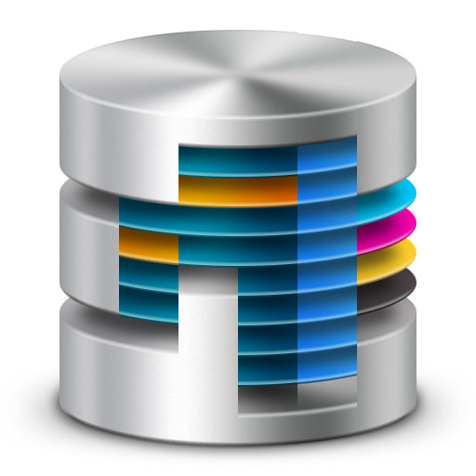
Database considerations
Index
Increase DTU
Notes:
2
https://docs.microsoft.com/en-gb/sql/relational-databases/sql-server-index-design-guide?view=sql-server-2017
A [Database Transaction Unit] is a blended measure of CPU, memory, and data I/O and transaction log I/O in a ratio determined by an OLTP benchmark workload designed to be typical of real-world OLTP workloads. Doubling the DTUs by increasing the performance level of a database equates to doubling the set of resource available to that SQL optimization Your organization might be using Azure SQL Database for your data back end, to take advantage of its rich administration capabilities and interoperability. However, a poorly implemented design won’t handle concurrency, and you might have to increase the database transaction unit (DTU) size and, therefore, the cost.
For example, Microsoft IT built the Thrive Conference app for an internal conference that had 1,700 attendees. The back end was a 100-DTU SQL Database instance. During performance testing, Microsoft asked 120 employees in its operations center to open the app simultaneously. The app stopped responding. Network traces showed that HTTP 500 errors were thrown from the PowerApps connection object. The SQL logs indicated that the server was fully utilized, and that calls were timing out.
Because there was no time to rewrite the app before the conference, Microsoft IT increased the scale to 4,000 DTU to meet the concurrency requirements. Therefore, the cost was significantly higher than the 100-DTU server that was originally budgeted. Since then, Microsoft IT has optimized the design by using the approach that’s described here. Now, a 100-DTU server is more than enough to handle the load, and the SQL calls are substantially faster. database.
2 minute

Slide 8
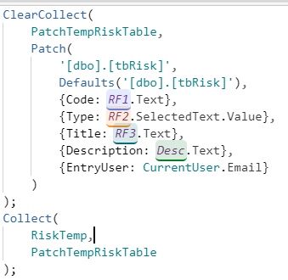
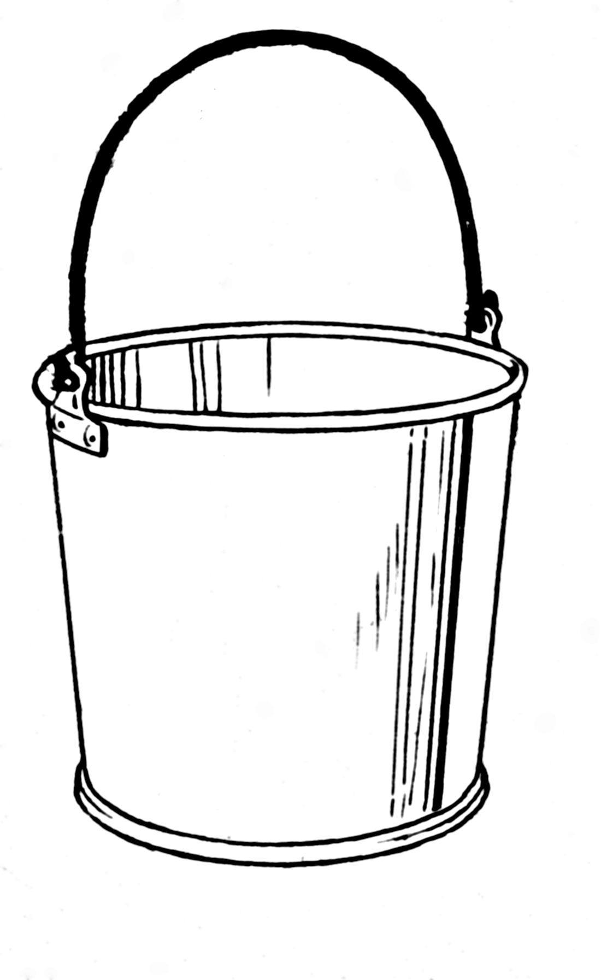

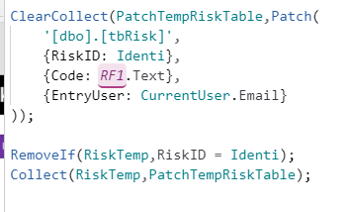
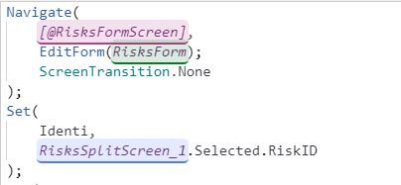

Patch & Collect Together
RiskTemp
New Record
Edit Record

Slide 9
Recap
Formulae
Timer
Power Apps Settings
Buttons
Variables
Issues
Solution
Internet Speed
SQL Views
DB considerations

Slide 10
How to test the performance of your app?
Developer tool of Browser
Fiddler
Neo Load
Notes:
Can also use analytics preview

Slide 11
Jese Navaranjan
PowerBi & PowerApp Consultant
Altius
Twitter Handle @jesenav2
E-mail Address: jese.navaranjan@altius.co.uk
Notes:
2 minutes

Slide 12
Appendix : App Launch Code
ClearCollect( RefTemp, '[dbo].[tbReference]’);
Set( CurrentUser, User());ClearCollect( admin, '[dbo].[tbUser]’);
ClearCollect( OrgTemp, '[dbo].[tbOrgStructure]’);
Concurrent(
ClearCollect( RiskTempS1, Filter( '[dbo].[vwRiskSummary]', RiskID < 10000 ) ),
ClearCollect( RiskTempS2, Filter( '[dbo].[vwRiskSummary]', RiskID >= 2000 && RiskID < 1000 ) ),
ClearCollect( MilestoneTempS1, Filter( '[dbo].[vwMilestone]', MilestoneID < 2000 ) ),
ClearCollect(MilestoneTempS2, Filter( '[dbo].[vwMilestone]', MilestoneID >= 2000 && MilestoneID < 4000) ));
Concurrent(ClearCollect(RiskTempS,RiskTempS1, RiskTempS),ClearCollect( MilestoneTempS, MilestoneTempS1,MilestoneTempS2 ));
ClearCollect( RefStatus, {Value: "ALL"});Collect( RefStatus, Filter(RefTemp,ReferenceFor="Status"));

Slide 13
Looping Formulae
UpdateContext({ctxMinRecID: First(SortByColumns('[dbo].[vwRiskSummary]', "InsertionRank", Ascending)).InsertionRank});
UpdateContext({ctxMaxRecID: First(SortByColumns('[dbo].[vwRiskSummary]', "InsertionRank", Descending)).InsertionRank});
UpdateContext({ctxNumberOfPasses: RoundUp((ctxMaxRecID - ctxMinRecID) / 500,0)});
ClearCollect( Numbers,
[1,2,3,4,5,6,7,8,9,10,11,12,13,14,15,16,17,18,19,20,21,22,23,24,25,26,27,28,29,30,31,32]);
ClearCollect(colNumbersTable, Filter(Numbers, Value <= ctxNumberOfPasses));
Clear(colMyBigTable1DataRaw);
ForAll( colNumbersTable ,Collect
(colMyBigTable1DataRaw, Filter ('[dbo].[vwRiskSummary]',(InsertionRank - 1) > ctxMinRecID + ((Value - 1) * 500) && InsertionRank <= ctxMinRecID + (Value * 500))));

Slide 14
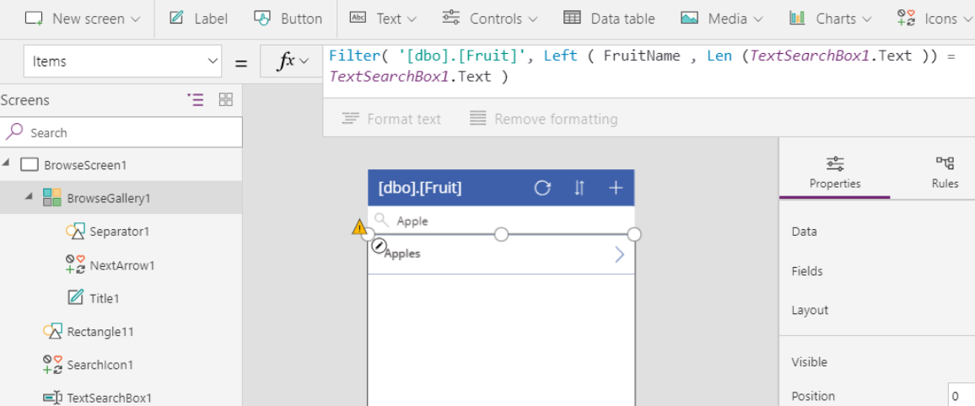
What is Delegation and what can we do to combat it?
Notes:
https://docs.microsoft.com/en-us/powerapps/maker/canvas-apps/delegation-overview#delegable-data-sources
Delegation is where the expressiveness of PowerApps formulas meets the need to minimize data moving over the network. In short, PowerApps will delegate the processing of data to the data source, rather than moving the data to the app for processing locally.
Working with large data sets requires using data sources and formulas that can be delegated. https://docs.microsoft.com/en-gb/connectors/sql/
4 mins

Slide 15


Using collections, and patterns for collections
Concurrency
Patch and Collection together
Looping collections
Notes:
Clear Collect Concurrent - https://docs.microsoft.com/en-us/powerapps/maker/canvas-apps/performance-tips
On Start
Clear Collect and Patch pattern
15 mins

Slide 16

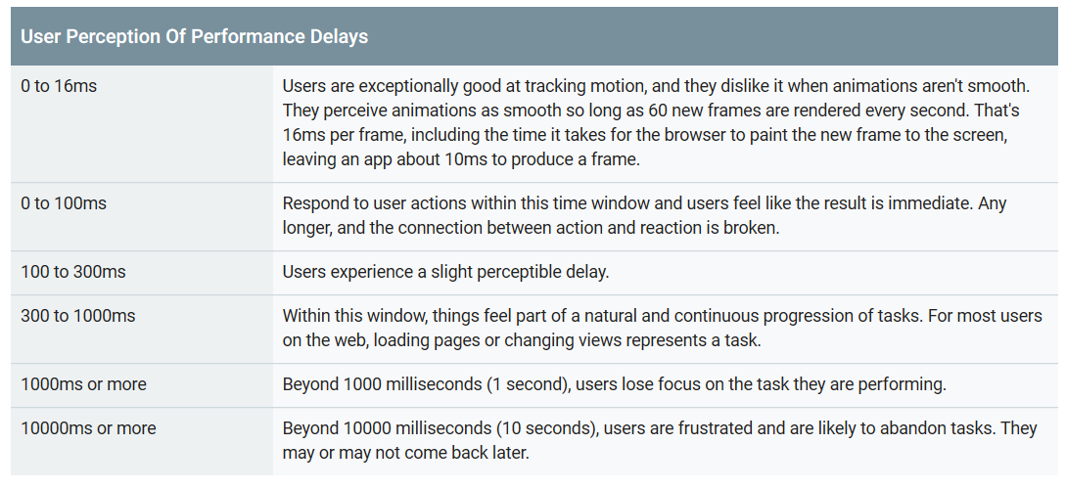
Using a timer for better user experience
Notes:
https://davidlozzi.com/2018/05/24/tips-to-entertain-your-users-while-powerapps-gets-their-data-i-e-loading-screens/
6 mins
https://loading.io/

Slide 17
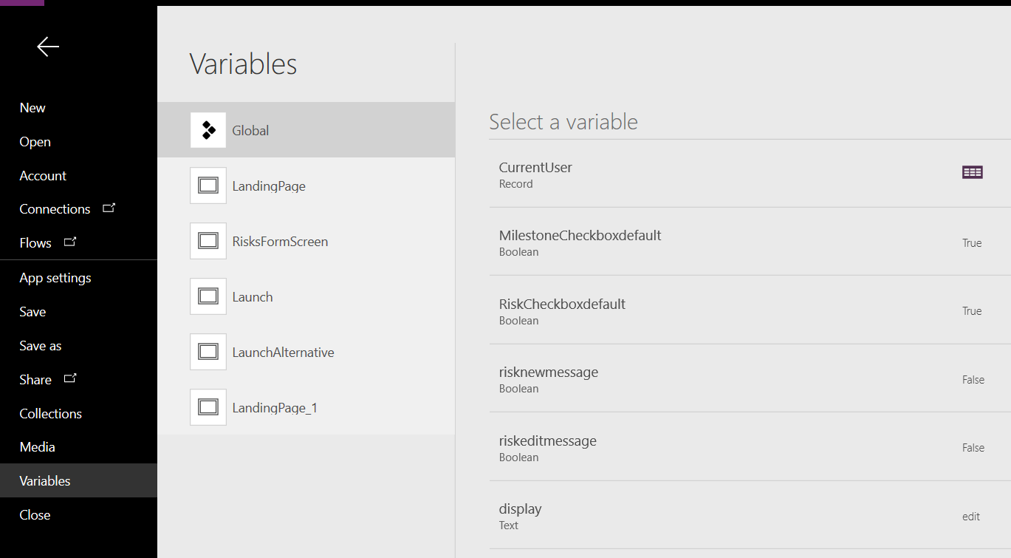
Using global variables and local variables to store data
Notes:
User()
Lookup tables store in cache
The User() function currently gets called by your app every time it is used. This can cause you app to slow down.
The quick answer is to cache the current user in a global variable when the app starts.
Set(CurrentUser, User())
3 mins

Slide 18
Power apps settings for better performance
User Delayed Load
Change Data row limit for non-delegable queries
Utilize on-Start
Notes:
1
https://docs.microsoft.com/en-us/powerapps/maker/canvas-apps/delegation-overview#delegable-data-sources Changing the limit
500 is the default number of records, but you can change this number for an entire app:
On the File tab, select App settings.
Under Experimental features, change the Data row limit for non-delegable queries setting from 1 to 2000.
Use Delayed Load
Turn on the experimental feature for Delayed Load if your app has more than 10 screens, no rules, and many controls that are on multiple screens and that are directly bound to the data source. If you build this type of app and don’t enable this feature, app performance may suffer because the controls in all screens must be populated even on screens that aren’t open. Also, all screens of the app must be updated whenever the data source changes, such as when the user adds a record.
1 minute

Slide 19
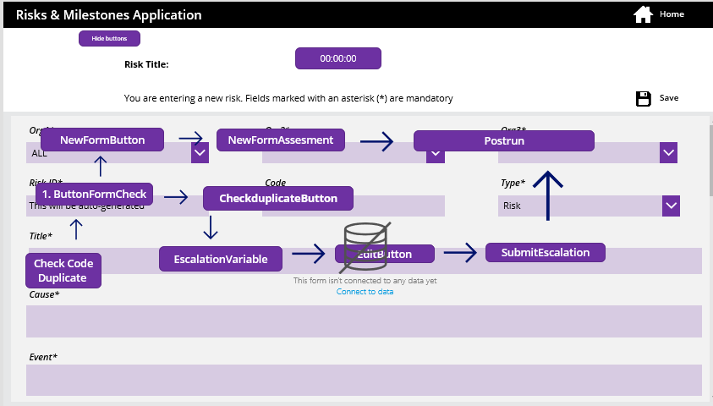
Using buttons to simulate logic in Power App
Notes:
5 mins

